Slide 1
WEEK 6
Process Control

Slide 2
wait and waitpid Functions
When a process terminates, either normally or abnormally, the kernel notifies the parent by sending the SIGCHLD signal to the parent.
Because the termination of a child is an asynchronous event—it can happen at any time while the parent is running — this signal is the asynchronous notification from the kernel to the parent.
The parent can choose to ignore this signal, or it can provide a function that is called when the signal occurs: a signal handler. The default action for this signal is to be ignored.

Slide 3
wait and waitpid Functions
For now, we need to be aware that a process that calls
wait or waitpid can
Block, if all of its children are still running
Return immediately with the termination status of a child, if a child has terminated and is waiting for its termination status to be fetched
Return immediately with an error, if it doesn’t have any child processes

Slide 4
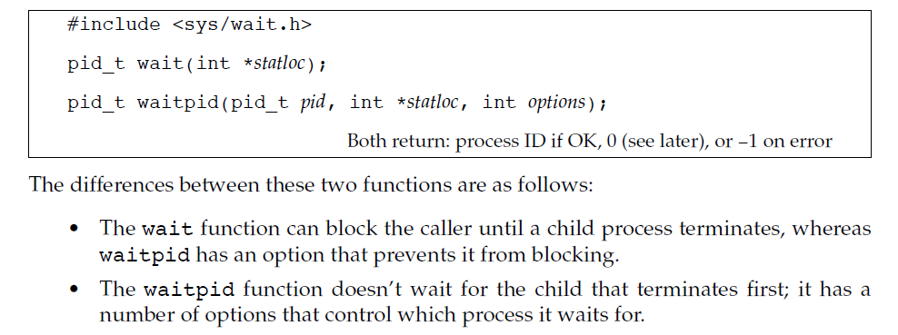
wait and waitpid Functions
If the process is calling wait because it received the SIGCHLD signal, we expect wait to return immediately.
But if we call it at any random point in time, it can block.

Slide 5
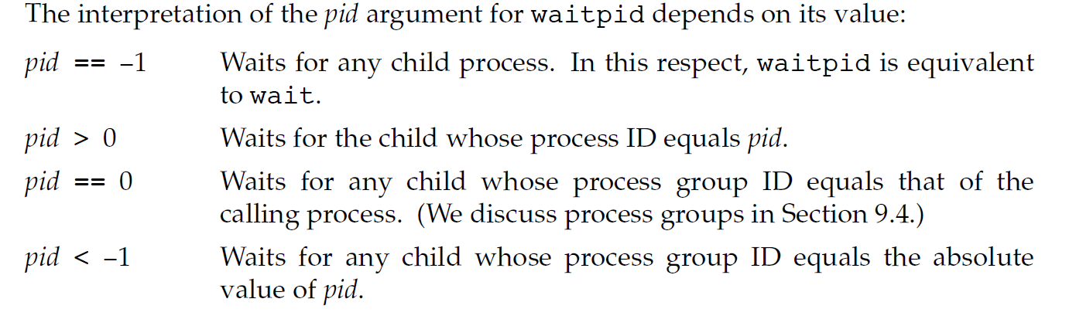
wait and waitpid Functions

Slide 6
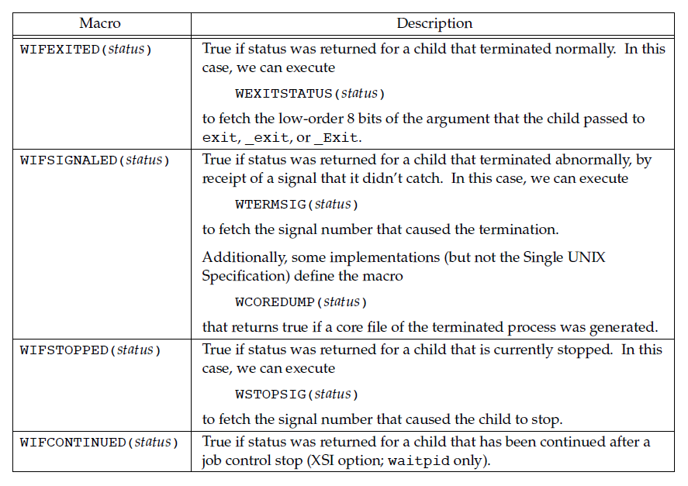
wait and waitpid Functions
Four mutually exclusive macros tell us how the process terminated, and they all begin with WIF.
The four mutually exclusive macros are

Slide 7
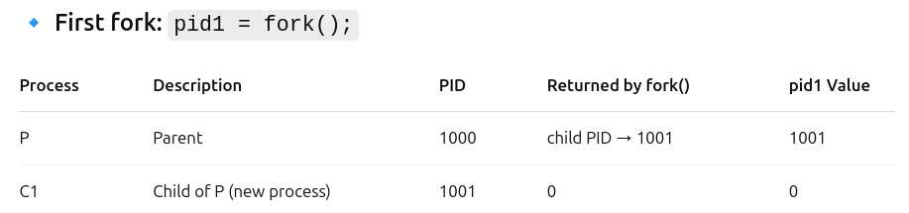
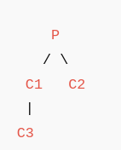
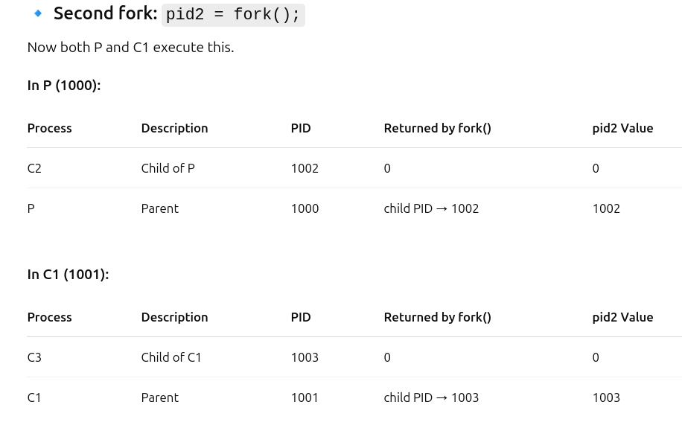
1.Write a C Program to demonstrate the working of wait and waitpid system calls with a program.

Slide 8
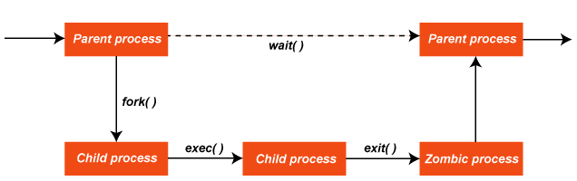
2. Write a program to demonstrate the zombie state of a process and provide the solution for the same.
A zombie process or defunct process is a process that has completed execution, but still has an entry in the process table.
This occurs for the child processes, where the entry is still needed to allow the parent process to read its child's exit status.
Once the exit status is read via the wait system call, the zombie's entry is removed from the process table.
A child process always first becomes a zombie before being removed from the resource table.

Slide 9
2. Write a program to demonstrate the zombie state of a process and provide the solution for the same.
An orphan process is a process that is still executing, but whose parent has died.
When the parent dies, the orphaned child process is adopted by init (process ID 1).
When orphan processes die, they do not remain as zombie processes; instead, they are waited on by init.
The result is that a process that is both a zombie and an orphan will be reaped automatically.

Slide 10
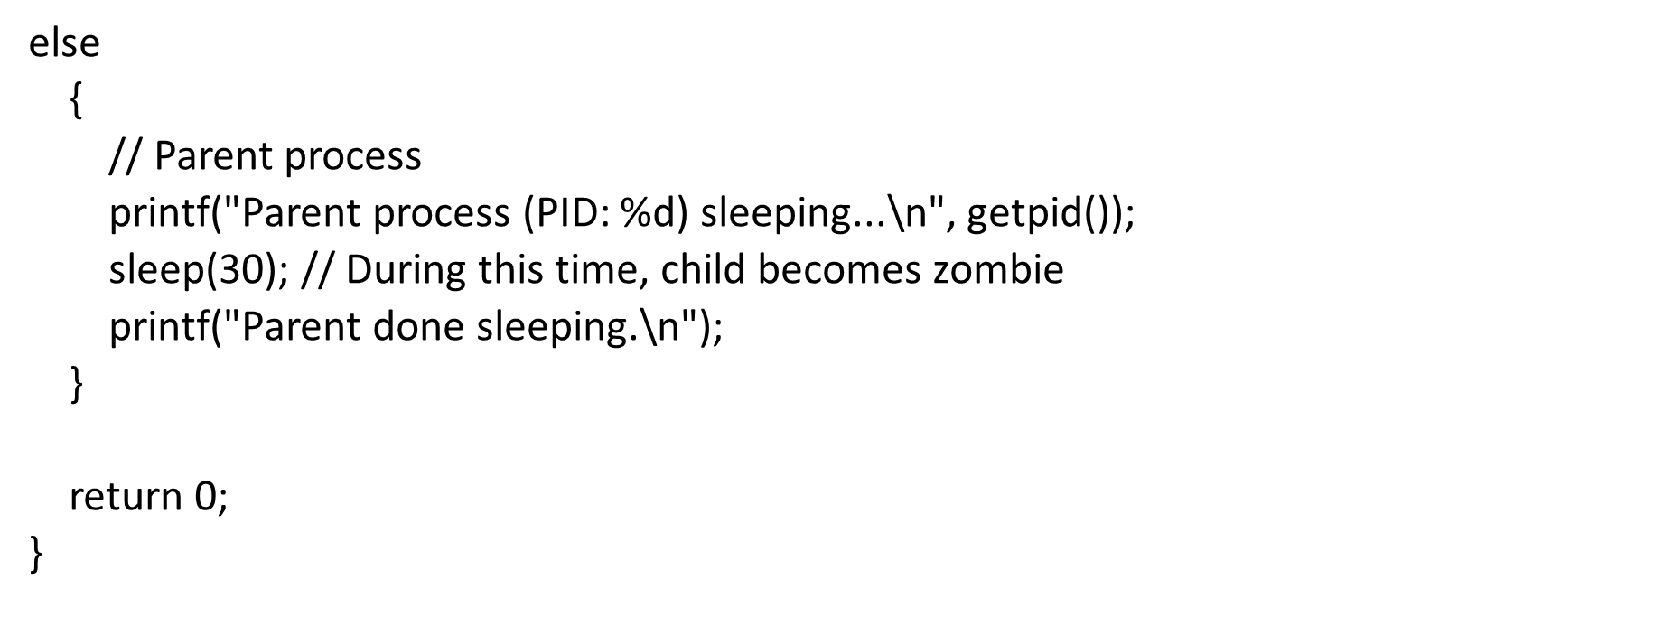
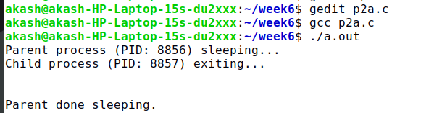
#include <stdlib.h>
#include <unistd.h>
#include <errno.h>
#include <stdio.h>
int main()
{
pid_t pid = fork();
if (pid < 0)
{
printf("Fork failed");
exit(EXIT_FAILURE);
}
else if (pid == 0)
{
// Child process
printf("Child process (PID: %d) exiting...\n", getpid());
exit(0);
}

Slide 11
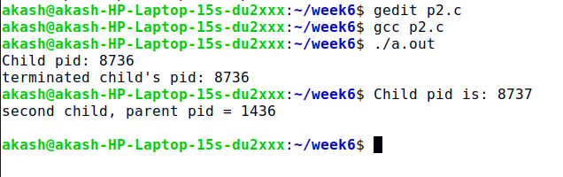
2. Write a program to demonstrate the zombie state of a process and provide the solution for the same.

Slide 12
3. Write a C program to create a child process and show how parent and child processes will share the text file and justify that both parent and child share the same file offset.
Opens a file test.txt in read-write mode.
Calls fork() to create a child process.
When fork() is used:
The child process inherits file descriptors from the parent.
Both processes refer to the same open file table entry in the kernel.
So, they share the file offset, meaning reading in one affects the other.
Both child and parent read from the same file, using the same file descriptor.
The file offset is shared, so each read() call affects the next.

Slide 13
4. Write a C program to demonstrate race condition between parent and child processes
A race condition occurs when the behavior of a program depends on the timing or sequence of uncontrollable events such as process scheduling.
Specifically, it's a flaw that arises when:
Two or more processes (or threads) access shared data or resources concurrently, and
At least one of them modifies the data or resource, and
The final result depends on the order in which the accesses take place.

Slide 14
4. Write a C program to demonstrate race condition between parent and child processes
A race condition between a parent and child process happens when the two processes access shared resources (like files, pipes, or memory) or perform actions (like reading/writing) without proper synchronization, and the outcome depends on the timing or order in which the processes are scheduled to run.

Slide 15
THANK YOU

